Slide 1
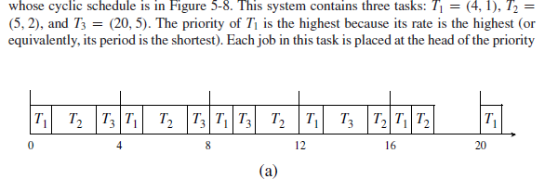
RM ALGORITHM

Slide 2
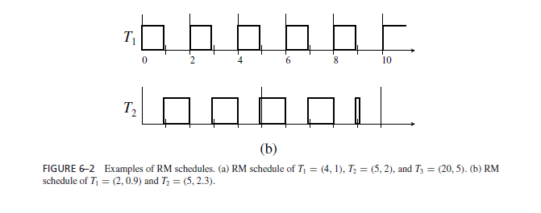
RM scheduling for T1(2,0.9) and T2(5,2.3)

Slide 3
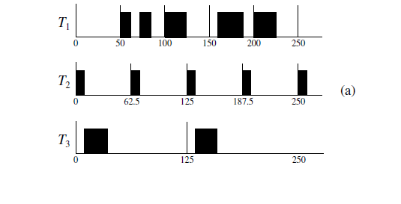
Deadline Monotonic Algorithm for T1 (50,50,25,100) T2 (0,62.5,10,20) T3 0,125,25,50)

Slide 4
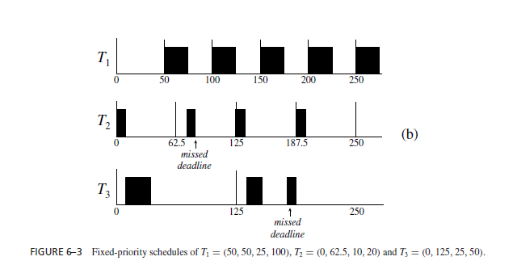
When the relative deadline of every task is proportional to its period The RM and Dm algorithms are identical when the relative deadline are arbitrary the DM algorithm performs better in the sense that DM algorithm can sometimes produce a feasible schedule when RM fails while the RM fails always when DM fails. The example is shown below for the three task which ahs feasible DM schedule but not RM

Slide 5
Dynamic priority scheduling
EDF
LST
FIFO
LIFO

Slide 6
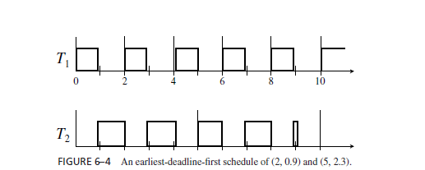
EDF Scheduling of T1(2,0.9),T2(5,2.3)
Till time 0 to 4, T1 has the highest priority, at time 4 T2 has higher prority than T1,when job j2,2 is completed T2 again has lower priority.
EDF there fore is Task level dynamic priority and job level fixed priority algorithm.because once the job is placed in job queue it cannot change.

Slide 7
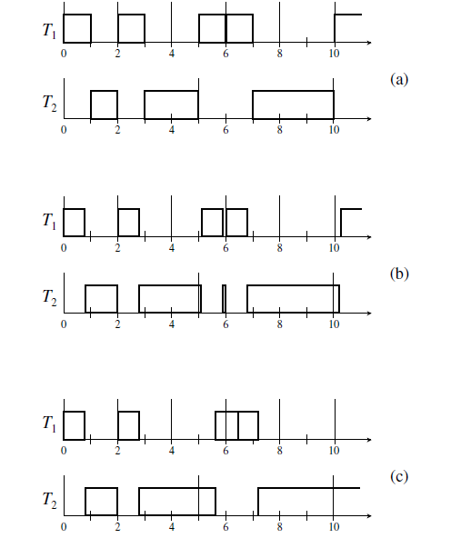
FIGURE 6–5 Unpredictability and instability of the EDF algorithm. (a) An EDF schedule of T1 = (2, 1) and T2 = (5, 3) with U = 1.1. (b) An EDF schedule of T1 = (2, 0.8) and T2 = (5, 3.5) with U = 1.1. (c) An EDF schedule of T1 = (2, 0.8) and T2 = (5, 4.0) with U = 1.2.

Slide 8
MAXIMUM SCHEDULABLE UTILIZATION
we say that a system is schedulable by an algorithm if the algorithm always produces a feasible schedule of the system. A system is schedulable (and feasible) if it is schedulable by some algorithm, that is, feasible schedules of the system exist. We now ask how large the total utilization of a system can be in order for the system to be surely schedulable.

Slide 9
Schedulable Utilizations of the EDF Algorithm
A system T of independent, preemptable tasks with relative deadlines equal to their respective periods can be feasibly scheduled on one processor if and only if its total utilization is equal to or less than 1.

Slide 10
Schedulability Test for the EDF Algorithm
we call a test for the purpose of validating that the given application system can indeed meet all its hard deadlines when scheduled according to the chosen scheduling algorithm a schedulability test. If a schedulability test is efficient, it can be used as an on-line acceptance Test.

Slide 11

To determine whether the given system of n independent periodic tasks surely meets all the deadlines when scheduled according to the preemptive EDF algorithm on one processor, we check whether the inequality n is satisfied.
We call this inequality the schedulability condition of the EDF algorithm. If it is satisfied, the system is schedulable according to the EDF algorithm. When is not satisfied, the conclusion we may draw from this fact depends on the relative deadlines of the tasks. If Dk ≥ pk for all k from 1 to n, then Eq. reduces to U ≤ 1, which is both a necessary and sufficient condition for a system to be feasible. On the other hand, if Dk < pk for some k, Eq. is only a sufficient condition; therefore we can only say that the system may not be schedulable when the condition is not satisfied.

Slide 12
Schedulable Utilization of the RM Algorithm for Tasks with Di = pi
Specifically, the following theorem from [LiLa] gives us a schedulable utilization of the RM algorithm. We again focus on the case when the relative deadline of every task is equal to its period. For such systems, the RM and DM algorithms are identical.
THEOREM 6.11. A system of n independent, preemptable periodic tasks with relative deadlines equal to their respective periods can be feasibly scheduled on a processor according to the RM algorithm if its total utilization U is less than or equal to URM(n) = n(2^{1/n} − 1)

Slide 13
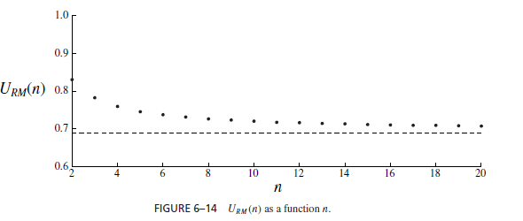
URM(n) = n(2^{1/n} − 1)

Slide 14
Time Demand Analysis

Slide 15
Schedulability of Fixed-Priority Tasks
We have identified several simple schedulability tests for fixed priority scheduling:
A system of n independent preemptable periodic tasks with Di = pi can be feasibly scheduled on one processor using RM if and only if U ≤ n⋅(21/n – 1)
A system of simply periodic independent preemptable tasks with Di ≥ pi is schedulable on one processor using the RM algorithm if and only if
U ≤ 1
[similar results for DM]
But: there are algorithms and regions of operation where we don’t have a schedulability test and must resort to exhaustive simulation
Is there a more general schedulability test? Yes, but not as simple as those we’ve seen so far…

Slide 16
Schedulability Test for Fixed-Priority Tasks
With short response time
Fixed priority algorithms are predictable and do not suffer from scheduling anomalies
The worst case execution time of the system occurs with the worst case execution time of the jobs
Unlike dynamic priority algorithms, which can exhibit anomalous behaviour
Use this as the basis for a general schedulability test:
Find the critical instant when the system is most loaded, and has its worst response time
Use time demand analysis to determine if the system is schedulable at that instant
Prove that, if a fixed-priority system is schedulable at the critical instant, it is always schedulable

Slide 17
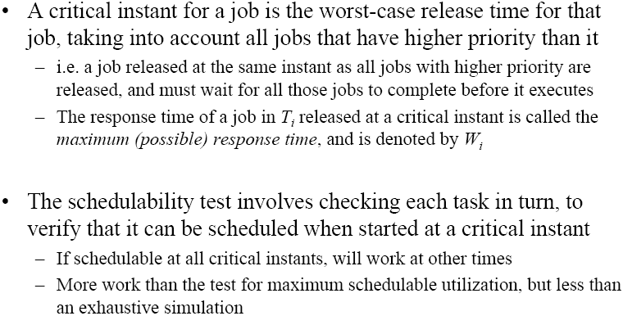
Critical Instant

Slide 18
Time-Demand Analysis

Slide 19
Time Demand Analysis…calculate
Example:
Test if is satisfied for
Test if is satisfied for
Test if is satisfied for
Time-Demand Function
Ok!
Ok!
Not satisfied!

Slide 20
Another example

Slide 21
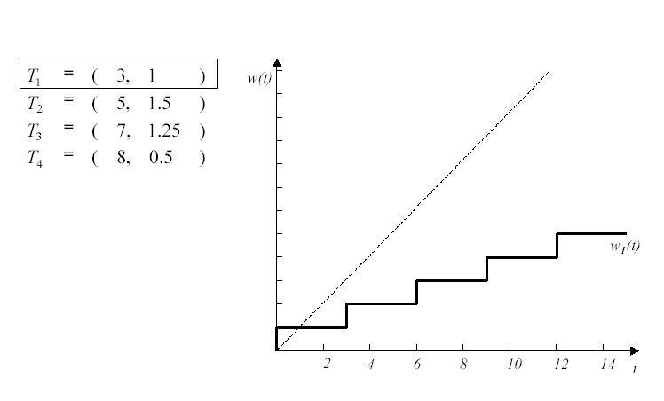
Another Example:
Step 1

Slide 22
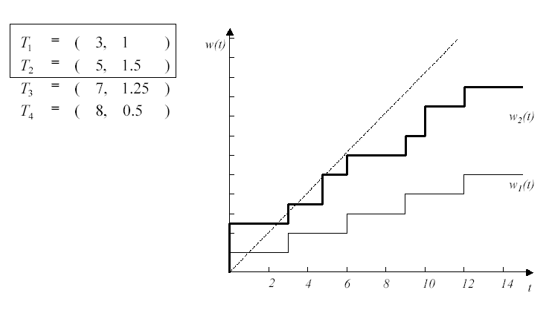
Example: Step 2

Slide 23
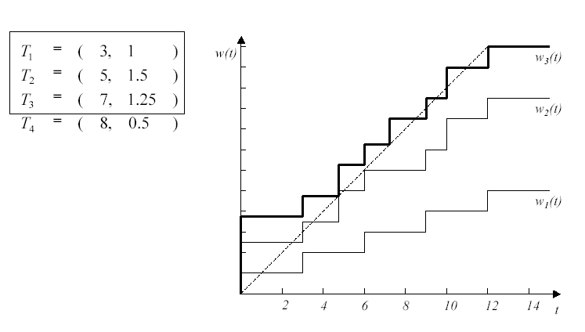
Example: Step 3

Slide 24
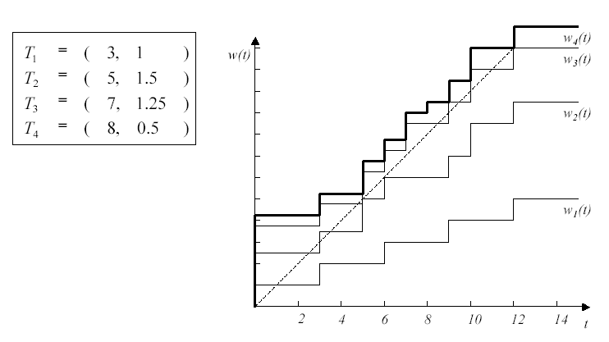
Example: Step 4

Slide 25
PRACTICAL FACTORS
so far, we have assumed that every job is preemptable at any time; (? If nonpreempatable)
once a job is released,it never suspends itself and hence is ready for execution until it completes; (? if suspends while waiting for resources)
scheduling and context-switch overhead is negligible;(cannot be taken granted)
the scheduler is event-driven and acts immediately upon event occurrences; (may not)
every task (or job) has a distinct priority; and
every job in a fixedpriority system is scheduled at a constant priority. These assumptions are often not valid

Slide 26
Blocking and priority inversion.
A (ready) job Ji is blocked when it is prevented from executing by a lower-priority job: The lower-priority job executes while Ji waits.
We say that a priority inversion occurs whenever a lower-priority job executes while some ready higher-priority job waits.

Slide 27
Nonpreemptability/ Blocking Time Due to Nonpreemptivity
There are many reasons for a job, or a portion of it, to be nonpreemptable.When a job is usinga resource (e.g., a critical section) that must be used in a mutual exclusive manner, making the job nonpreemptable while it has the resource is one way to ensure mutual exclusion.. A higher-priority job that becomes ready when a nonpreemptable lower-priority job is executing is blocked until the nonpreemptable portion of the lower-priority job completes. The delay due to blocking may cause the higher priority job to miss its deadline. Consequently, when we want to determine whether a task can meet all its deadlines, we must consider not only all the tasks that have higher priorities than it, but also the nonpreemptable portions of lower-priority tasks.

Slide 28

Effect of blocking on schedulability
Add the amount of blocking time due to the lower pririty task due to nonpreemptability or deffered execution..

Slide 29
Self-Suspension
While executing, a job may invoke some external operation, for example, an I/O operation or a remote procedure, that is executed on another processor. Self-blocking or self-suspension occurs when the job is suspended and waits until such an operation completes before its execution can continue. While it waits, the operating system removes it from the ready queue and places it in a blocked queue. We assume that the maximum amount of time each external operation takes to complete and, hence, the maximum duration of each self-suspension, is known. (This time can be an upper bound on the maximum response time of the external operation obtained by doing a time-demand analysis of all the tasks on the processor where the operation executes.)

Slide 30
Context Switches
We now confine our attention to job-level fixed-priority assignment, that is, each job is given a fixed priority throughout its execution. In such a system, each job preempts at most one job if there is no self-suspension. Hence, each job suffers at most one context switch when it starts execution and another context switch when it completes. We can account for the context-switch overhead(CS0) in a schedulability test by including the time spent for the two context switches at the start and completion of each job as part of the execution time of the job.

Slide 31
Limited-Priority Levels
A real-life system can support only a limited number s of priority levels. (For example, the IEEE 802.5 token ring provides only 8 priority levels, and real-time operating systems provide no more than 256 priority levels.) As a consequence, tasks (or jobs) may have nondistinct priorities.

Slide 32
Tick Scheduling
An important assumption underlying all the schedulability tests described above is that the scheduler is event-driven: Upon the occurrence of every scheduling event, the scheduler executes immediately. Hence, every job is inserted into the ready job queue immediately after it becomes ready. This assumption is sometimes not valid. A way to implement the scheduler is to make it time-driven. By this we mean that the execution of the scheduler is triggered by a timer which is set to expire periodically. Scheduling decisions are made at these time instants, called clock interrupts. This method is called tick scheduling or time-based scheduling. We now focus on the case when the scheduler executes only at clock interrupts.

Slide 33
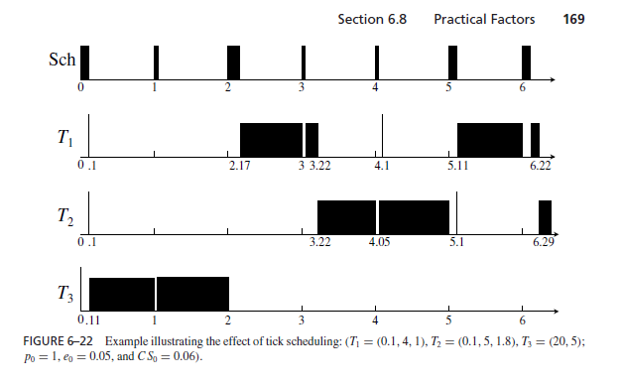
Tick scheduling
The first section of T3 is nonpreemptable and execution time of this section is 1.1

Slide 34
1. At time 0.05 after the scheduler finishes serving the clock interrupt at time 0, it finds only J3,1 in the pending queue and moves the job to ready queue. This job begins to execute at time 0.11 and immediately enters its nonpreemptable section.
2. At time 1, both J1,1 and J2,1 have been released, but they are not ready for execution because J3,1 is still in its nonpreemptable section. The scheduler does nothing. J3,1 executes, exits its nonpreemptable section, and continues to execute.
3. At time 2, the scheduler finds J1,1 and J2,1 unblocked and moves them to the ready queue. The total time spent by the scheduler is 0.17. Hence, J1,1 begins to execute at time 2.17.
4. At time 3, the scheduler finds no job in the pending queue. J1,1 continues to execute after the scheduler completes servicing the clock interrupt. Upon the completion of J1,1, the next job J2,1 in the ready queue executes.
5. At time 4, the scheduler again finds no job in the pending queue. J2,1 continues to execute.
6. At time 5, J2,1 is still not complete. The scheduler finds J1,2 in the pending queue. (The job was released at time 4.1.) It moves J1,2 to the ready queue and places it ahead of J2,1. Consequently, when the scheduler completes at time 5.11, J1,2 begins to execute.
7. At time 6, the scheduler finds J2,2 in the pending queue, moves the job to the ready queue, and places the job after J1,2 and J2,1. At time 6.11, J1,2 executes. The job completes at 6.22. J2,1 resumes and subsequently completes at time 6.29. Then, J2,1 begins to execute and so on.

